Slide 1

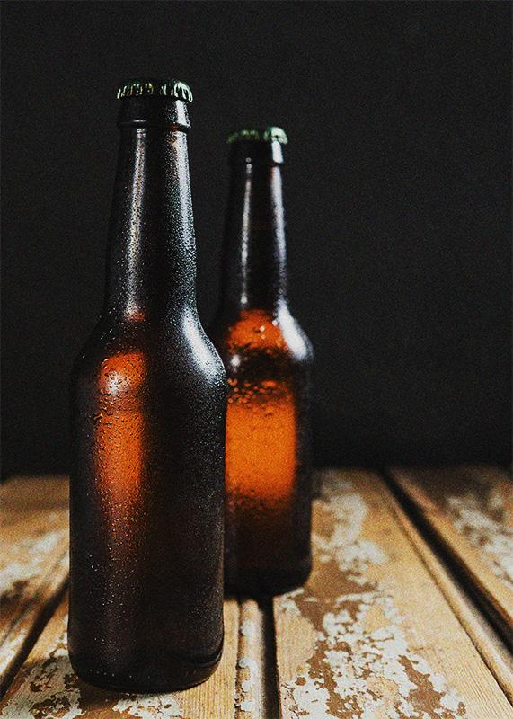
BEER
PRICE CHECKER
// March 2021 Deep Learning Project
Alex, Azwin, Jason

Slide 2
TABLE OF CONTENTS
01
02
03
04
MISSION & VISION
DATA COLLECTION
The Big Question
Method & Challenges
MODELLING
FUTURE IMPROVEMENT
Creation & Evaluation
What’s Next?

Slide 3
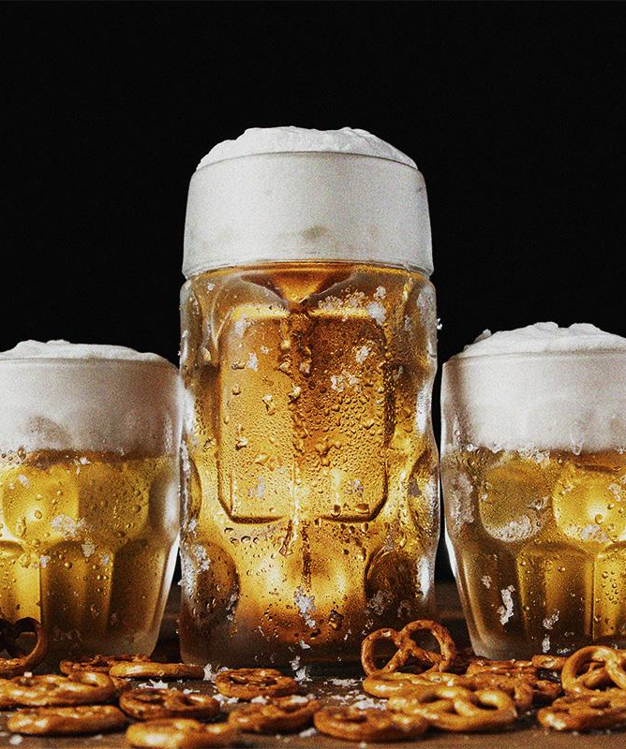
01
MISSION
& VISION

Slide 4
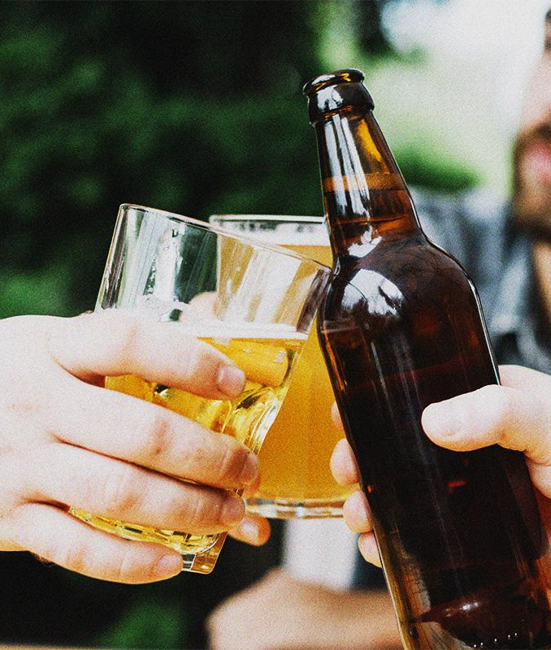
THE BIG QUESTION
HOW CAN WE
QUICKLY & EFFECTIVELY
CHECK THE PRICE OF RETAIL BEER?

Slide 5


PRODUCT DESCRIPTION
INPUT
PROCESS
OUTPUT
Customer takes a photo of a product
App will evaluate photo and find information for that beer
App will output prices from retailers

Slide 6
THE PROCESS
CREATE MODEL
COLLECT DATA
DEPLOY
EVALUATE

Slide 7
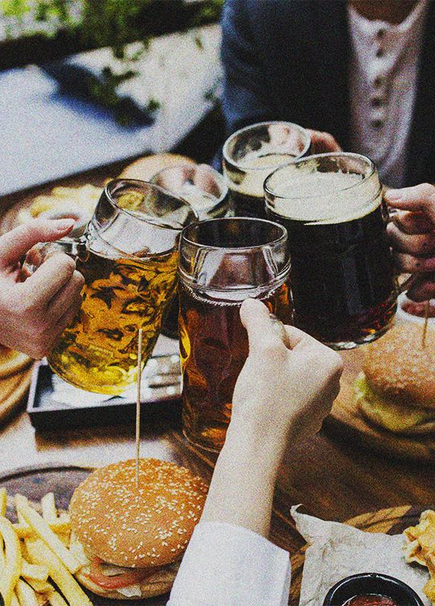
02
CHEERS!
CHEERS!
CHEERS!
DATA
COLLECTION

Slide 8
DATA WE NEED
PRICES
BEER PHOTOS
Consumer Council Price Watch
18 brands listed
Google Image Search
Self Data Collection
3,500+ images

Slide 9
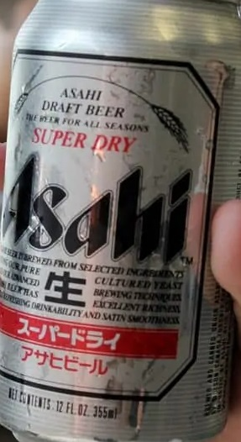
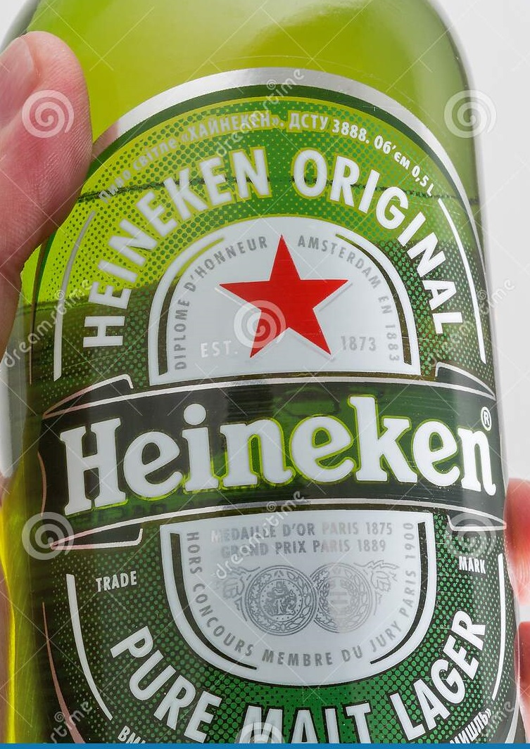
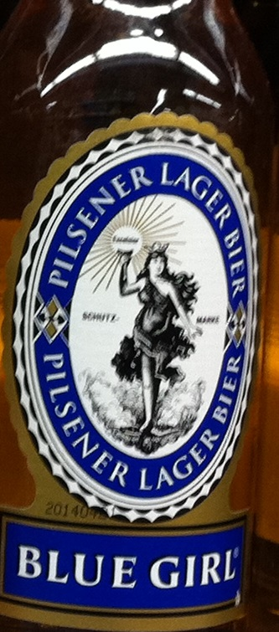
SAMPLE DATA
ASAHI
HEINEKEN
BLUE GIRL

Slide 10
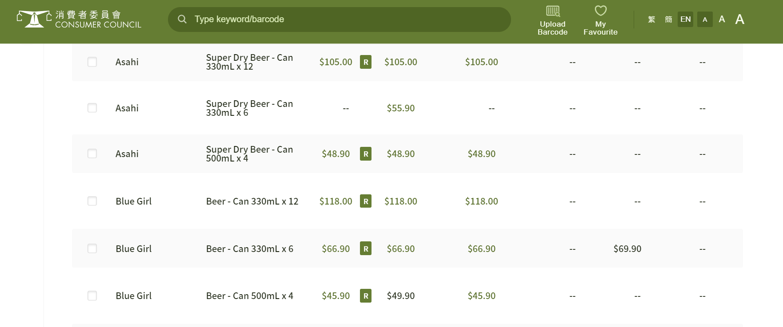
SAMPLE DATA
CONSUMER COUNCIL PRICEWATCH

Slide 11
THE CHALLENGES
DATA VOLUME
HIDDEN ELEMENTS
Difficult to find sufficient samples for all beers.
Consumer Council Website not BS4 friendly.
CROPPING
CATEGORIZING
Photos not scaled similarly.
Inbac Quick Cropper
No automated brand categorization.
All manual.

Slide 12
03
MODELLING

Slide 13
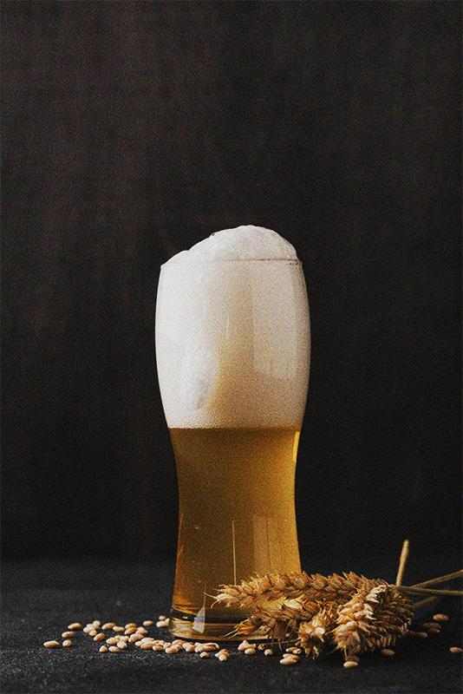
THE STEPS
CREATE BASELINE
EVALUATE & REBUILD
STREAMLIT DEPLOYMENT

Slide 14
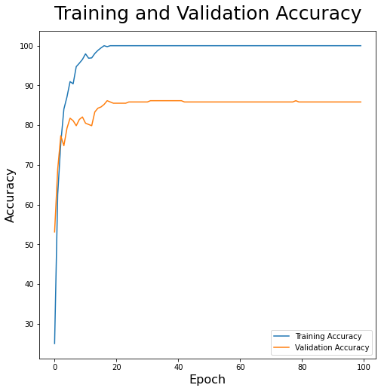
CREATE BASELINE
~85% Validation Accuracy
Basic CNN Boilerplate
Mix of Conv2D, MaxPool, Dense
Overfit on Training Data
Validation Accuracy capped

Slide 15
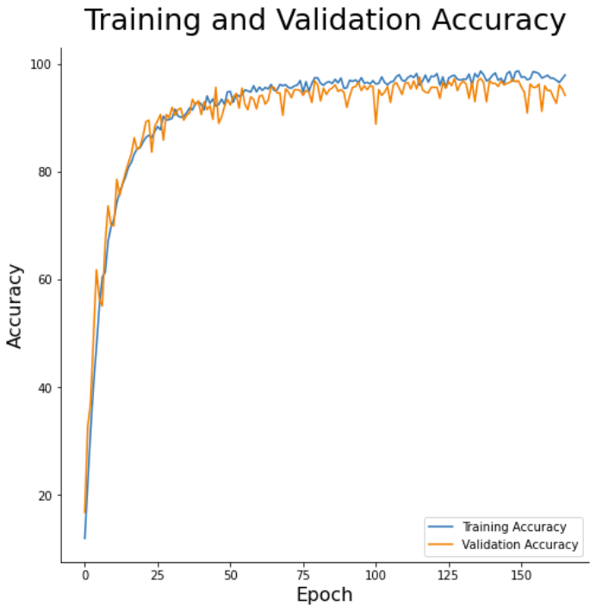
EVALUATE & REBUILD
98.96% Validation Accuracy
Augmentation
Flip, Rotate, Zoom
Colour Contrast
Layering / Regularization
Filter Sizes
Global Average Pooling
Dropout
Kernel Regularizer
Early Stopping

Slide 16

STREAMLIT DEPLOYMENT
FEATURES
Desktop Version:
Upload image file
Mobile Version
Take live photo from camera
Upload image file
Instant price search & display
Per Unit Price
Comparison between retailers
Save photo to folder for future training data addition.

Slide 17
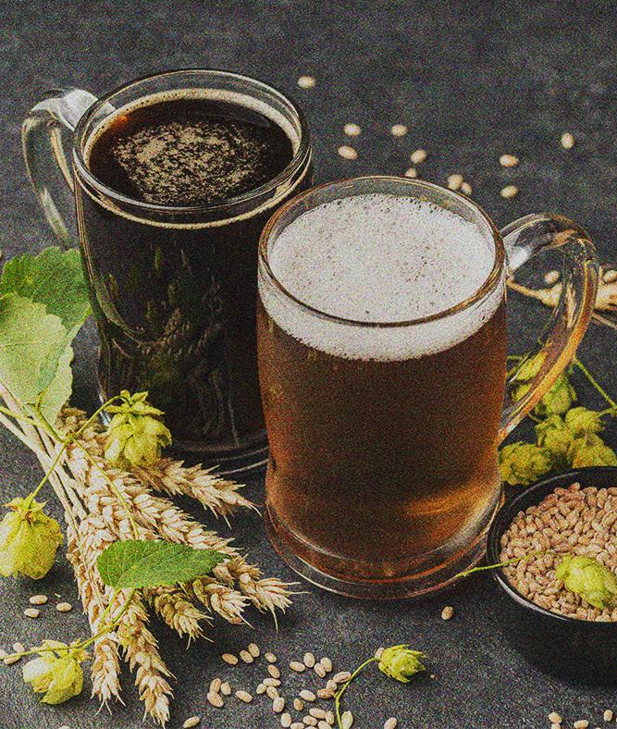
LIVE
DEMO

Slide 18
04
FUTURE
IMPROVEMENT

Slide 19
CURRENT MODEL IMPROVEMENTS
MORE IMAGE DATA
ALT MODEL
Have a larger training database for higher accuracy.
Use SIFT image feature detector or YOLO.
DEPLOYMENT
MORE SOURCES
Deploy on Flask for more customizable UI.
Currently prices only sourced from Consumer Council website.

Slide 20
WHAT’S NEXT
PHASE 1
PHASE 3
Current Model
Appstore Deployment
PHASE 2
PHASE 4
Add Categories
IPO & Get Rich

Slide 21
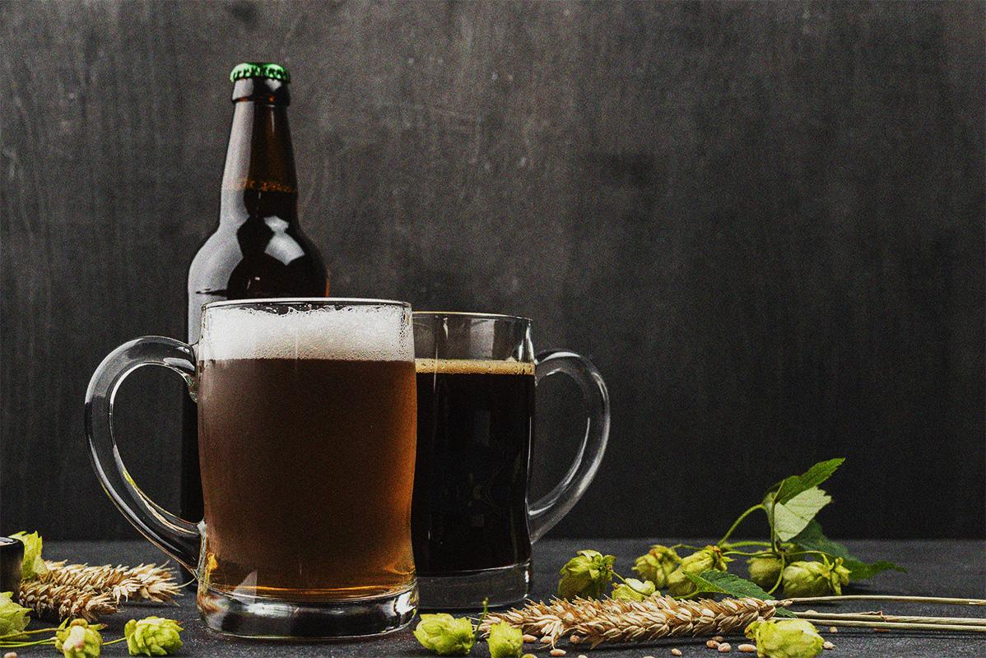
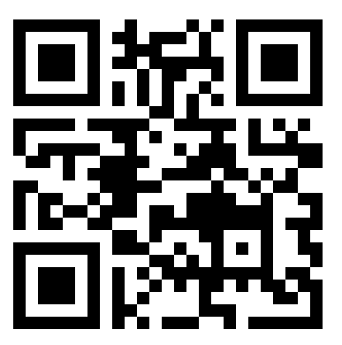
THANKS!
QUESTIONS?
TRY OUR APP AT:
http://tinyurl.com/beerpricechecker

